Slide 1

Your first Elm program
Briefly about Elm
Jump in and swim
An app on GitHub pages
Per Lundholm Crisp

Slide 2
Survey
How many consider themselves
Developers?
Front end developers?
Back end developers?
Full stack developers?

Slide 3
What happened?
I was happily doing server side rendered web pages with some Ajax
Then, one day I was no longer a developer, I was a backend developer
I decided to learn some JavaScript to get back into doing the whole thing

Slide 4
JavaScript – what are thou?
Meteor
Angular
React
React Native
NativeScript

Slide 5

Elm to the rescue
A pure functional language for the web
Compiles to JavaScript
On the box it says:
No runtime errors in practice. No null. No undefined is not a function.
Friendly error messages that help you add features more quickly.
Well-architected code that stays well-architected as your app grows.
Automatically enforced semantic versioning for all Elm packages.

Slide 6
Personally, I like
After hobby hacking and full time for 5 months:
Type safe to the bone, yet lean
No null, instead Maybe and handle both cases
No exceptions
No switch without handling all cases
When it compiles, it works – in runtime!
Refactoring guided by the compiler
All state in on place, not scattered about in components
Nice pattern for model, view and update
Small footprint
Fast

Slide 7






The nice clean world of Elm
Safe
JavaScript
REST
Port
Json Decode/Encode

Slide 8
Why is type safe good?
How do you ensure program correctness?
By tests
What tests should you write to achieve above?
By sending a range of different input and check the result
So the bigger the range, the more tests?
Yes
What should you program do when the input is illegal?
Throw exception, return null or a status code.

Slide 9
Not so type safe Java
The domain of the parameter is maxed out
How do you write tests for that?
How does it effects the client of this method?

Slide 10
A bit better Java
ENOUGH!
The parameter need not be a Person

Slide 11
Let’s do Elm!
Like most language Elm has
Strings
“Agile means good”
Numbers
2 is an integer and 3.14 is a float
Lists
[“all”, “has” “to be”, “same”, “type” ]
Tuples
(“left”, godzilla, 14)

Slide 12
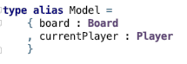
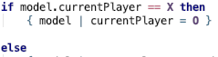
Elm Records
Please note the syntax for creating a new record based on the current

Slide 13
Elm modules
Modules
A module encapsulates its functions and types unless they are exposed (made public)
Access other modules by import.

Slide 14
Elm functions
Functions
A function will always return the same result for a given input.
Getting the time of day or generating a random number are not functions.

Slide 15
Structure of an Elm app
Model
The one and only for the whole app across all your pages.
View
The view is a function that takes the model and presents it.
If user can interact with something, it will result in a Message
Update
Takes a Message and the Model.
Creates the next state of the Model.

Slide 16
Get wet

Slide 17
Mission: Tic-tac-toe
Game of Tic-tac-toe
2 players
A grid of 3x3
Each player in turn places their marker on the grid
Markers are X and O, respectively
Objective is to have 3 in a row, column or diagonally

Slide 18
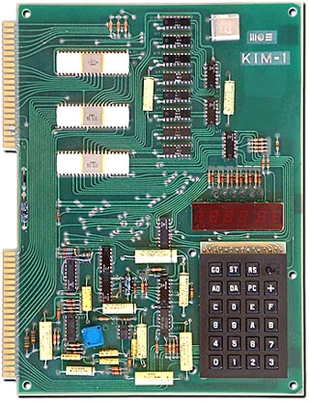
Project: Tic-tac-toe
One of my first programs was a 3x3 Tic-tac-toe
It learnt by its mistakes.
Don’t ask me how the board was presented.
Now, let’s do this for the web!
An 8-bit processor with 2K RAM and I/O. Display: 6 LED numbers. Hexadecimal keyboard.

Slide 19
Status check
Who has a laptop?
Of those, who has prepared their laptops according to the instructions?
https://crispab.github.io/elm-workshop/
Who has published to GitHub pages?

Slide 20
Step 0
Clone the workshop source.
git clone https://github.com/crispab/elm-workshop
Clone your project repository.
git clone https://github.com/<username>/<project-repository>
cd <project-repository>
elm init
cp ../elm-workshop/index.html .
cp ../elm-workshop/src/Main.elm src
cp ../elm-workshop/*.sh .

Slide 21
Deploy an Elm app
Run the project app and see that it works.
sh run.sh
Publish it to GitHub pages.
git push
Notes:
Run.sh kräver elm-live

Slide 22
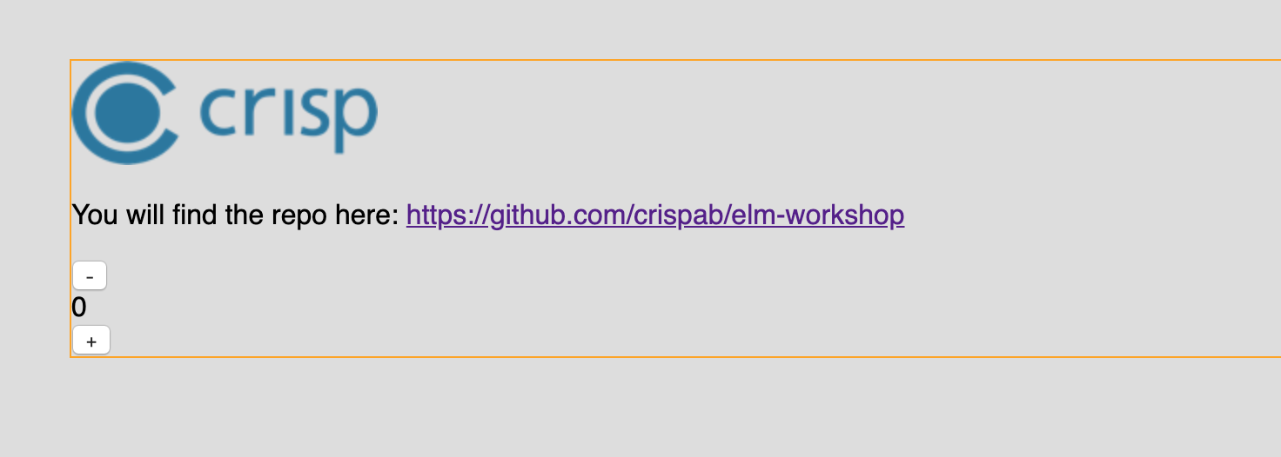
http://localhost:8000

Slide 23
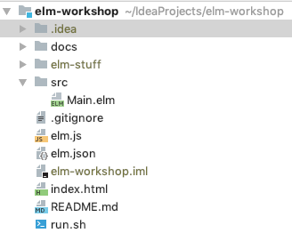


Walkthrough of the Counter Example
Notes:
Look at the Elm code.
Look at the index.html
Look at the run.sh

Slide 24
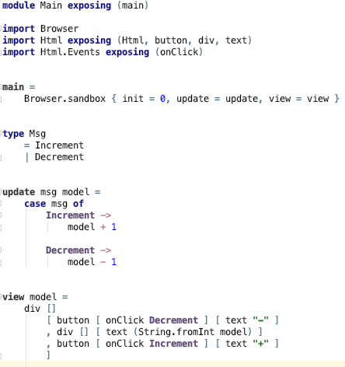
Main.elm

Slide 25
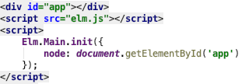
index.html

Slide 26
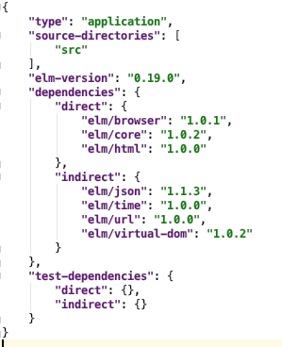
elm.json

Slide 27
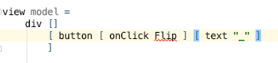
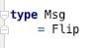
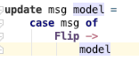
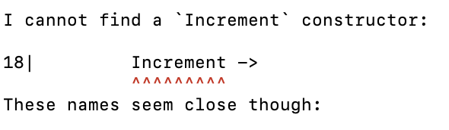
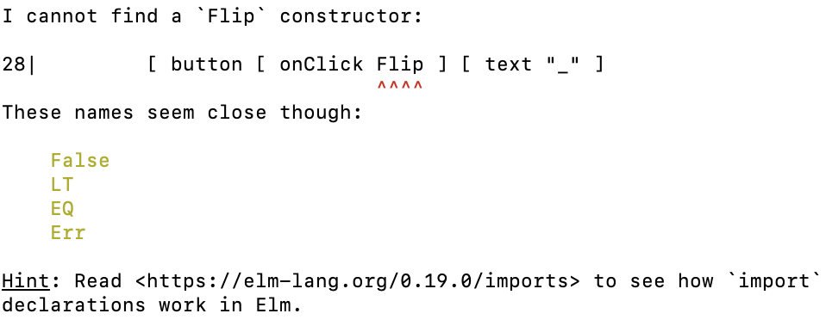
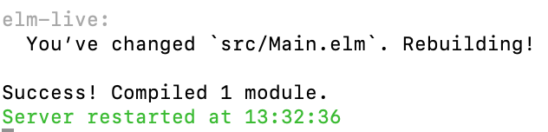
Step 1a: A flipping button
Notes:
Start off with changing the view. We get a compiler error.
Add the Flip message. Now the update function is wrong.
Fix the update. Compiles!

Slide 28
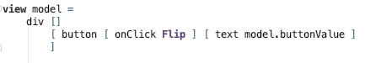
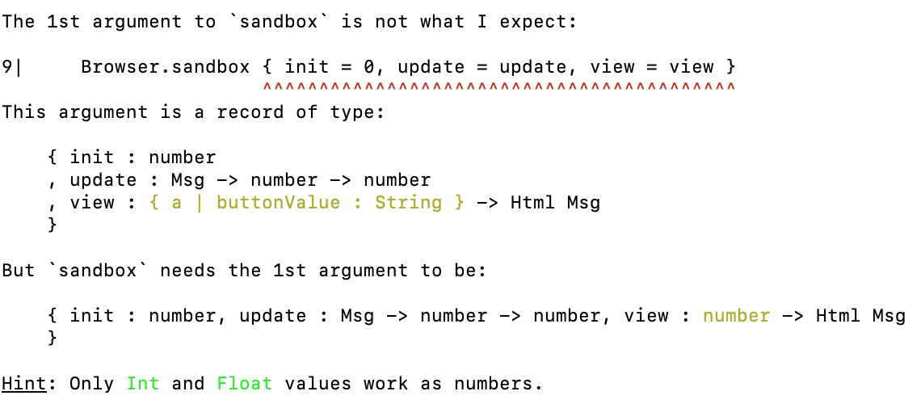
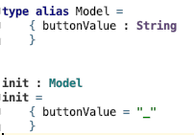
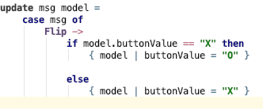

Step 1b: Change the face
Notes:
Let’s add a buttonValue to our model. Interesting compiler error.
Create a Model and let init be a function that returns it.
Compiles!
type defines and names a new type (which behaves like an enum with data attached), and type alias gives a name to an existing type.
type alias isn’t creating a distinct type, it is literally just giving a name to an existing type. A type alias will save you keystrokes, but do nothing more.

Slide 29
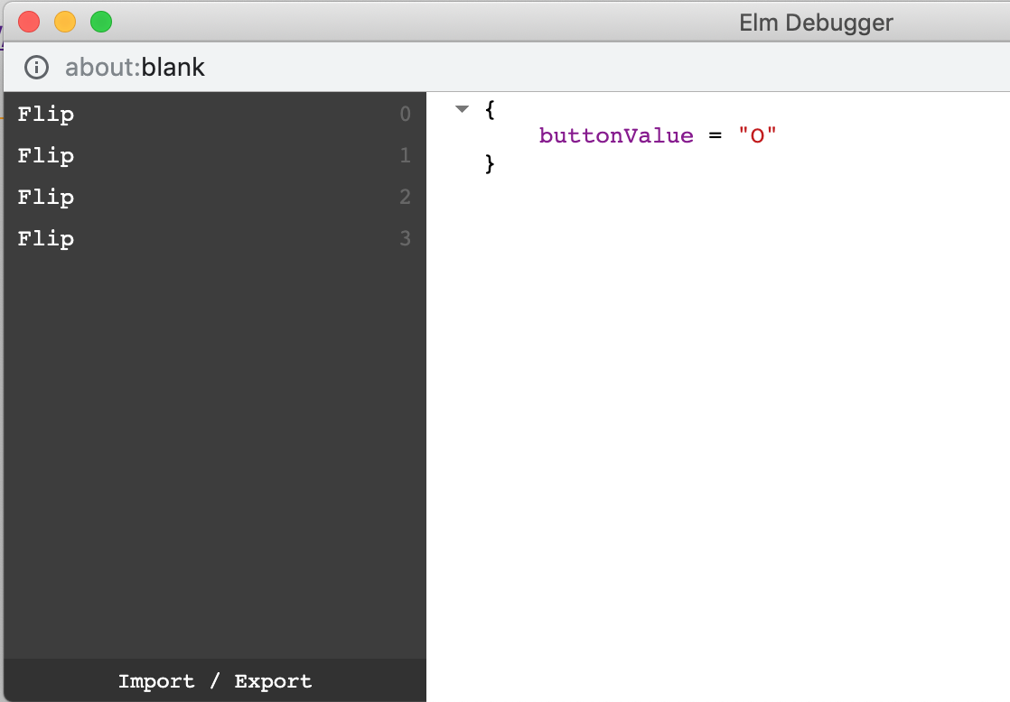
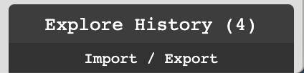
Elm’s time-travelling debugger
Notes:
Noticed the little black thing in the lower right corner? Click on it.
To the left are messages and to the right is the state of the model that resulted from processing the message.
Click on them to see the different states.

Slide 30
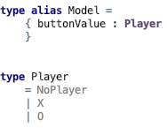
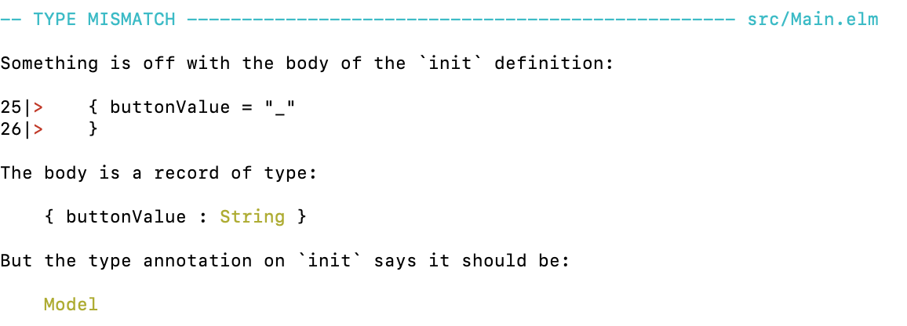
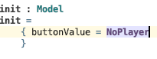
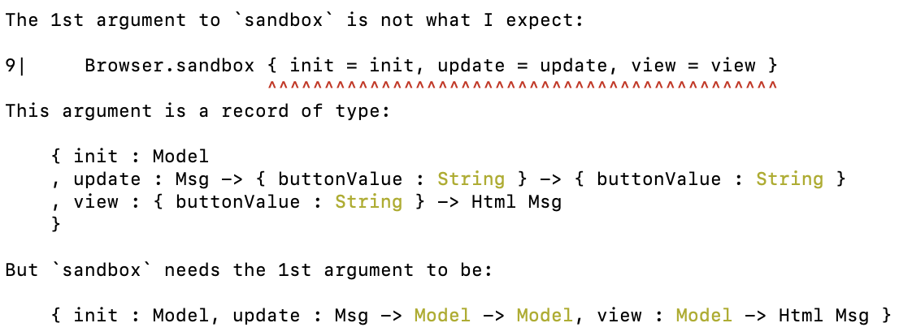


Step 1c: Remove string based logic
Notes:
Using a string for logic is error prone. Let’s introduce a type!

Slide 31

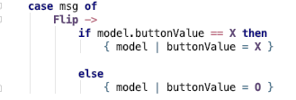
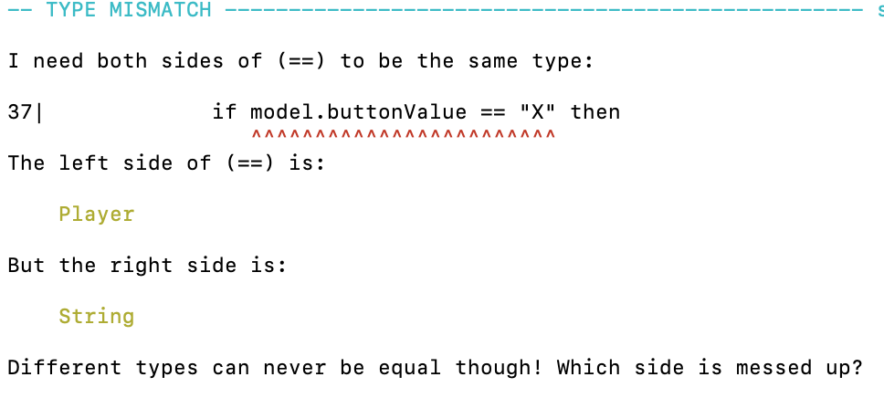
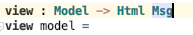
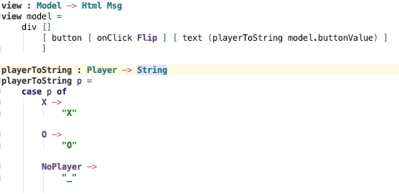
Step 1c: Remove string based logic
Notes:
So to get a grip, let’s introduce type declarations for update and view functions.

Slide 32
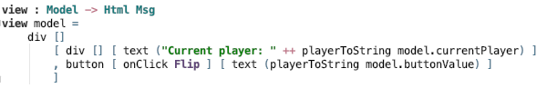
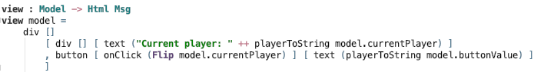
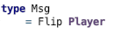
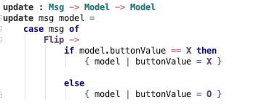
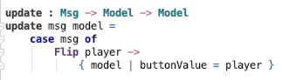

Step 2a: Current player
Notes:
We wish to show how is next in turn so we will introduce the current player concept in the model.
Let’s also make current player part of the button message.

Slide 33
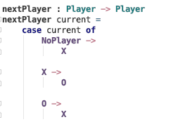
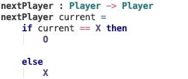
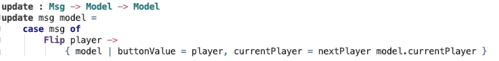

Step 2b: Change current player
Notes:
When a player makes a move, then the next player becomes the current player.

Slide 34
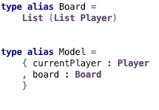
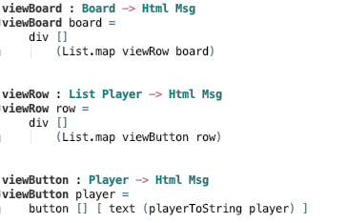
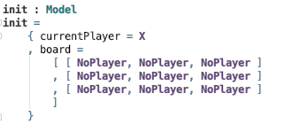
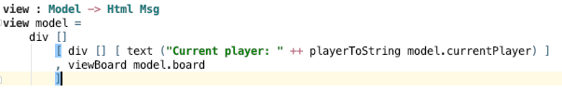
Step 3a: A board
Notes:
We want a 3x3 board, how shall we represent that? There are options but we select a list of lists.
We use List.map to display the board.

Slide 35
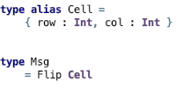
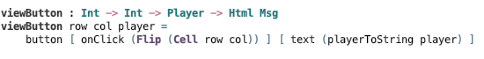
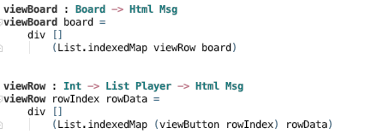
Step 3b: Flip message
Notes:
The Flip message now needs to tell us which cell it was, as there are now 9 and not one.
But how do we get the row and column? We use an indexed map!

Slide 36
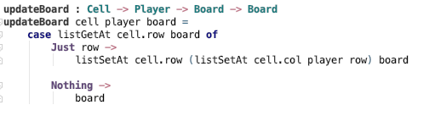
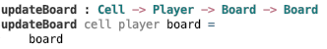
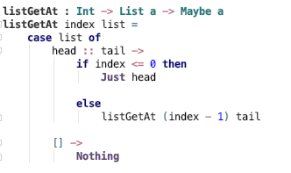
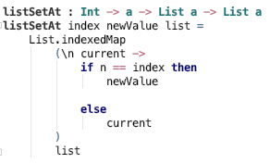
Step 3c: Update the board
Notes:
We want to update the board when someone clicks. So let’s say we have an updateBoard function.
First make a empty function. How do you replace a value in a list? We will show you one way.
But to set the value in a list of list, we first need to get the list that is the row.
Look how we do pattern matching on lists in the case statement.
Now we have both set and get so we can update the board.

Slide 37
Epilogue
More on the tic-tac-toe
Determine winner, play against computer (AI), graphical styling, sound, arbitrary large board.
Official guide: https://guide.elm-lang.org/
Example projects that requires no backend
The dice game of the book “The Goal” by Goldrath
Show lead time and throughput
Text based adventure game
The original from the 70’s is available online (see docs)
Loan calculator
How much can you borrow given interest and expenses?

